Slide 1
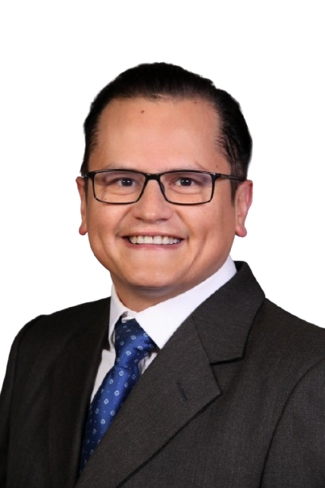



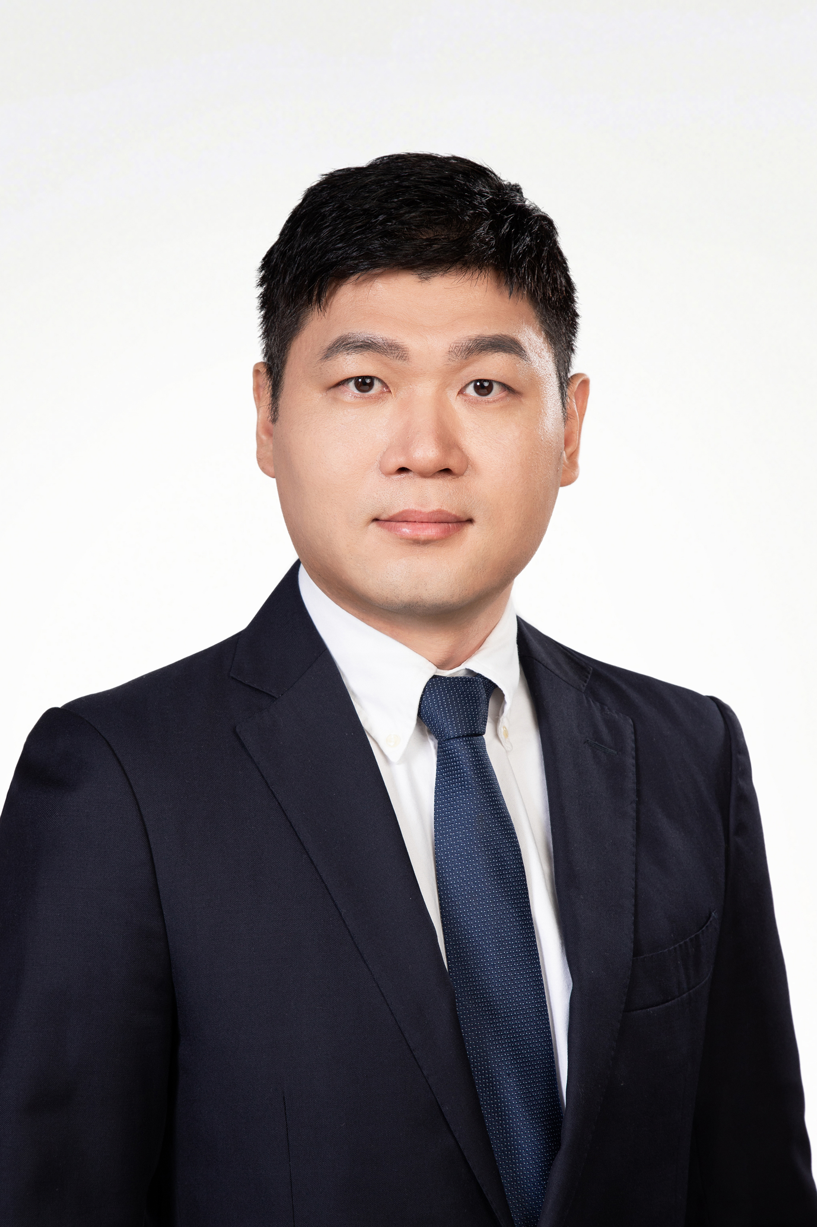
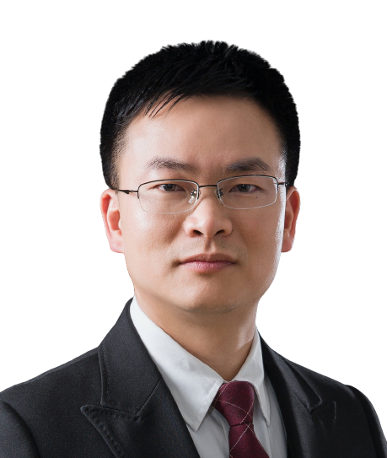
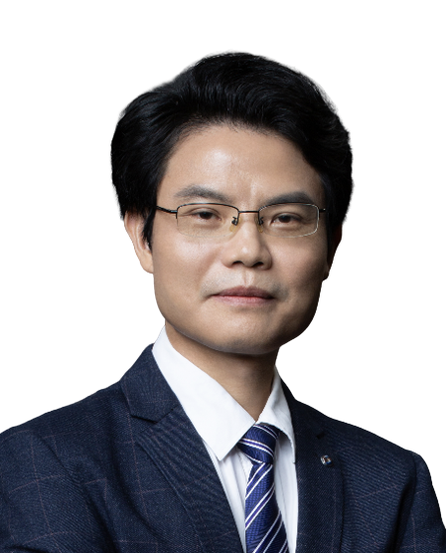
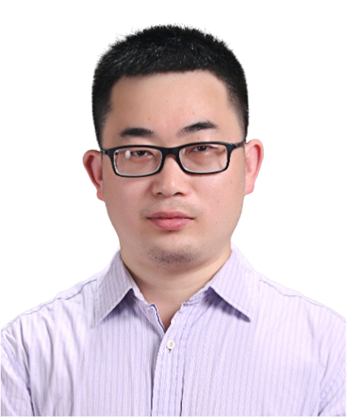


Multiscale models of RNA/RNA-proteins: representing physical properties towards interpretable structure prediction
Zoom meeting link: https://us06web.zoom.us/j/85859345873?pwd=amxPPBu7EPzCvHf7iZO5HW72TuQaLB.1
Bilibili：https://live.bilibili.com/26427894
Zoom ID: 858 5934 5873
Passcode: 123456
Time (China): 2024-11-25 16:00 PM
Time (CET): 2024-11-25 9:00 AM
Horacio V. Guzman
Instituto de Ciencia de Materiales de Barcelona
Universidad Autónoma de Madrid, Spain
Abstract:
Electrostatic and nanomechanical interactions are crucial for the assembly, disassembly and stability of highly-charged biopolymers like RNA and some IDPs. At the molecular scale, elucidating the organization, energetic rules and structure of e.g. RNA-Protein interactions in viruses is a major challenge in biomacromolecular research. Numerous coarse-grained (CG) and enhance-sampling models have been introduced to alleviate those issues. Those methods are generally known as ̈multiscale ̈, which can be useful to represent biological and bio-material systems with less degrees-of-freedom, and hence tackle particular questions about diverse biophysical phenomenologies, like adsorption, electrostatic interactions in variational environments (different salinities and pH gradients), mechanical deformation, among many others. In this talk, I will present recent in-house developments of multiscale methods for the interfaces between RNA-proteins and RNA-membranes.
The first part of this talk focuses on models that provide deeper electrostatic and mechanical insights of the RNA-protein/membrane shell interaction and viral assembly process. Aiming to learn from those viruses and use them as guidelines for laying-out functional context-dependent nanocarriers. Finally, the speaker will briefly present their structure prediction pipelines for RNA used during CASP15 & some RNA puzzles, and discuss perspectives on what is next and where AI can boost predictions.
HOST＆PANELISTS
Host：Zhichao Miao
Guangzhou Laboratory
Guangzhou Medical University
Lin Huang
Sun Yat-sen University
Jianhua Yang
Sun Yat-sen University
Jinkai Wang
Sun Yat-sen University
Liqing Ye
Guangzhou Institutes of Biomedicine and Health
Sponsors
Notes:
https://us06web.zoom.us/j/83371159253?pwd=vKbGPpYr7OmbKhIPhLDzTmSWqwrCUm.1

Slide 2
RNA/RNA-蛋白的多尺度模型：代表可解释结构预测的物理性质
Zoom meeting link: https://us06web.zoom.us/j/85859345873?pwd=amxPPBu7EPzCvHf7iZO5HW72TuQaLB.1
Bilibili：https://live.bilibili.com/26427894
Zoom ID: 858 5934 5873
Passcode: 123456
Time (China): 2024-11-25 16:00 PM
Time (CET): 2024-11-25 9:00 AM
Horacio V. Guzman
巴塞罗那材料科学研究所
西班牙马德里自治大学
摘要：
静电和纳米机械相互作用对于高电荷生物聚合物（如RNA和某些内在无序蛋白，IDPs）的组装、解体和稳定性至关重要。在分子尺度上，阐明例如病毒中RNA-蛋白相互作用的组织、能量规则和结构是生物大分子研究中的一大挑战。为了缓解这些问题，已经引入了许多粗粒化（CG）和增强采样模型。这些方法通常被称为“多尺度”方法，可用来以较少的自由度表示生物和生物材料系统，从而解决有关多种生物物理现象的问题，例如吸附、变动环境（不同盐浓度和pH梯度）下的静电相互作用、机械变形等。在本次报告中，报告人将介绍他们团队最近开发的RNA-蛋白和RNA-膜界面的多尺度方法。报告的第一部分将重点展示一些模型，这些模型能够深入分析RNA-蛋白/膜壳相互作用以及病毒组装过程的静电和机械特性，旨在从这些病毒中学习并将其作为设计功能性、上下文相关纳米载体的参考。最后，报告人将简要介绍他们在CASP15及部分RNA难题中使用的RNA结构预测流程，并讨论未来的发展方向以及人工智能在提升预测能力方面的潜力。
主持人＆嘉宾
Host：Zhichao Miao
Guangzhou Laboratory
Guangzhou Medical University
Lin Huang
Sun Yat-sen University
Jianhua Yang
Sun Yat-sen University
Jinkai Wang
Sun Yat-sen University
Liqing Ye
Guangzhou Institutes of Biomedicine and Health
赞助商

